Slide 1
Direct Drive Electric Scooter
Matt Kokshoorn
Supervisor: Dr. Paul Gaynor

Slide 2
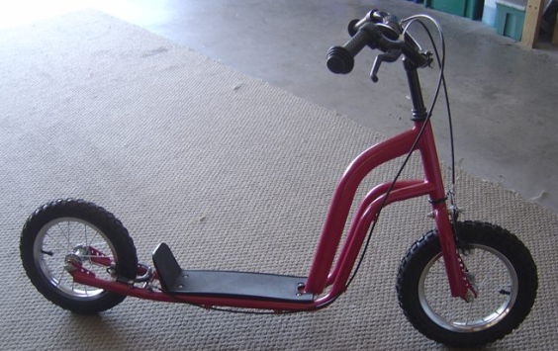
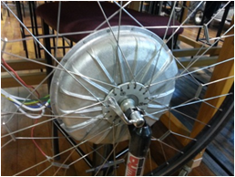
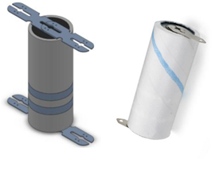
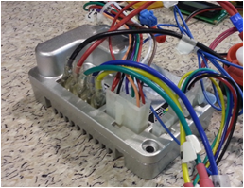

Motivation
“Design and build a Direct Drive Electric Scooter as an alternative form of short range urban transportation.”
A child’s scooter. - An Avanti-Electra BLDC Hub Motor.
- 40 $LiFePO_{4}$ Cells. - A Golden Motor BLDC Motor Controller.

Slide 3
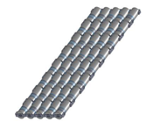
Specifications
Supply
8 series sets of 5 Paralleled cells giving,
26.4V ( 3.3V x 8 )
11.5 Ahr
303.6 Whr.
Motor
In standard operation the motor rating are,
- 400W Rated Power (15.15A at 26.4V).
- 800W Peak Power (30.3A at 26.4V).
Requirements
Implement an Overcurrent ‘Boost’ Feature.
Calculate and display Speed and Battery Information.
Implement Regenerative Braking.

Slide 4
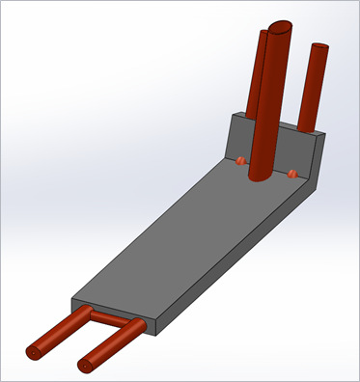
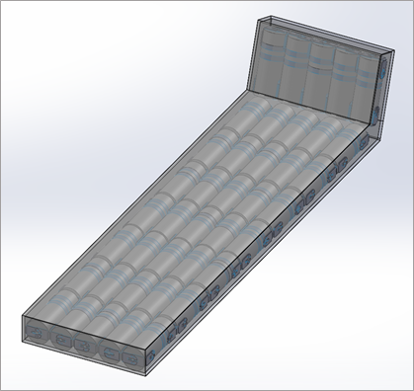
Mechanical Design
- Designed to hold 40 lithium iron phosphate cells each weighing 72g (2.88kg Total)
- To be fabricated from aluminum sheet metal.

Slide 5
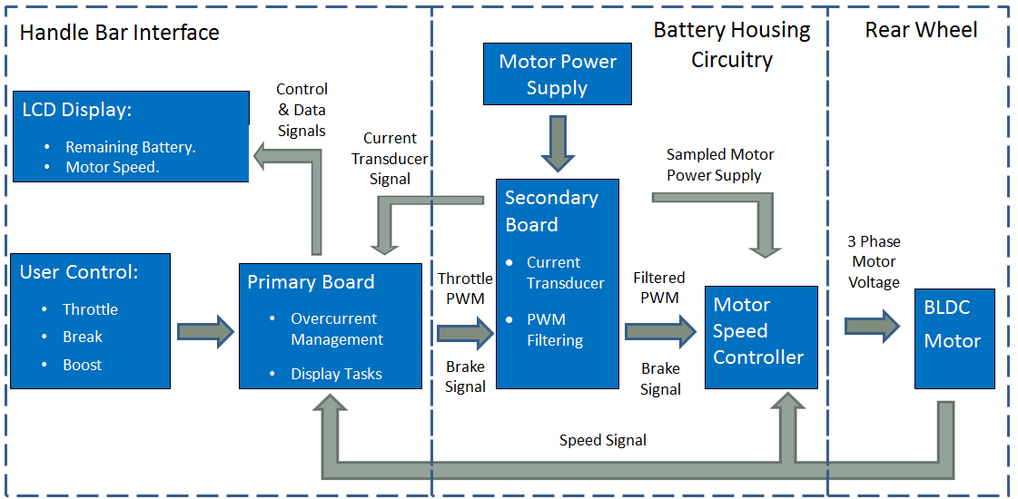
Proposed Electrical System Overview

Slide 6
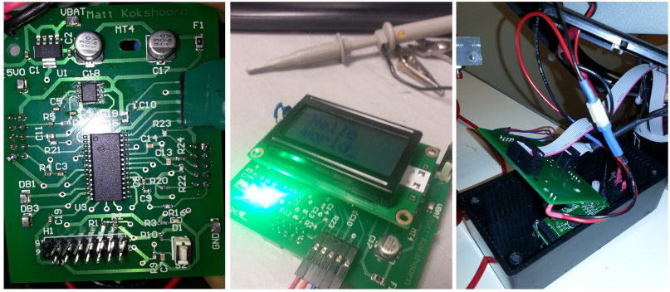
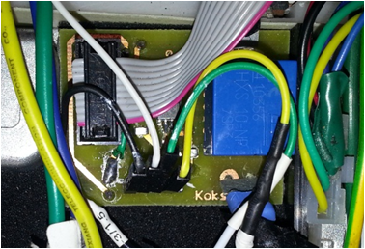
Electrical Realisation – Two Boards
Primary Board:
PIC18F25K50.
Several Interrupt Lines.
10 Bit ADC’s and PWM
Carries out overcurrent control.
MIDAS LCD Display (Mounted).
Secondary Board:
LEM Current Transducer (Current -30-30A).
PWM Filtering.

Slide 7


Signal Conditioning
1st Order RC Filter
2nd Order Sallen-Key Filter
$$f_{c}=\frac{1}{2πτ}=\frac{1}{2πRC}$$
$f_{c}=\frac{1}{2π\sqrt{R_{1}R_{2}C_{1}C_{2}}}$
- Due to noise from high motor currents, varying levels of filtering was required on each signal. (Throttle, Current and Speed).
- 2nd Order Low Pass Sallen Key Used for PWM – Also provided Low Output Impedance.

Slide 8
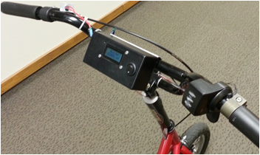
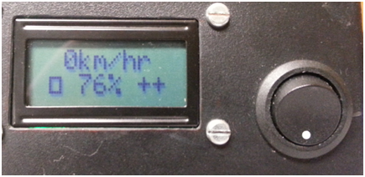
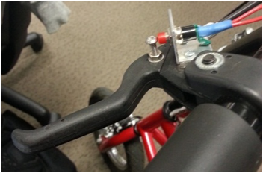
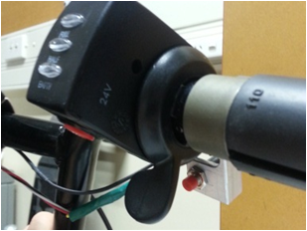
User Interface
LCD Display
Regenerative Braking Button Thumb Throttle and Boost Button

Slide 9
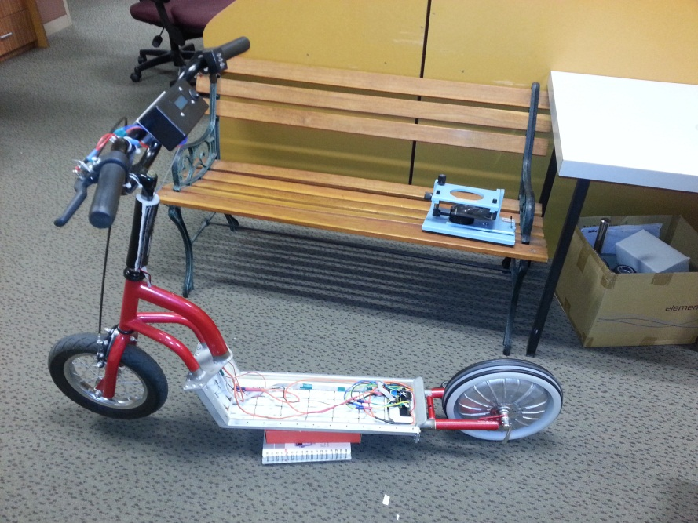
Final Implementation
Motor Speed Controller and Secondary Board
Handlebar Interface (Primary Board)
Battery Array
BLDC Hub Motor

Slide 10
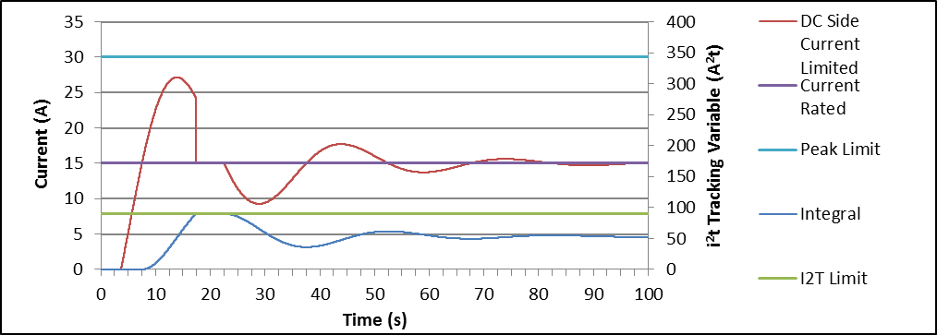

Overcurrent Algorithm - $i^{2}t$
Basis – Motor can be run at twice the rated current for 60 seconds when boost is activated.
Should provide periods of increased acceleration while preventing thermal damage to the motor.

Slide 11
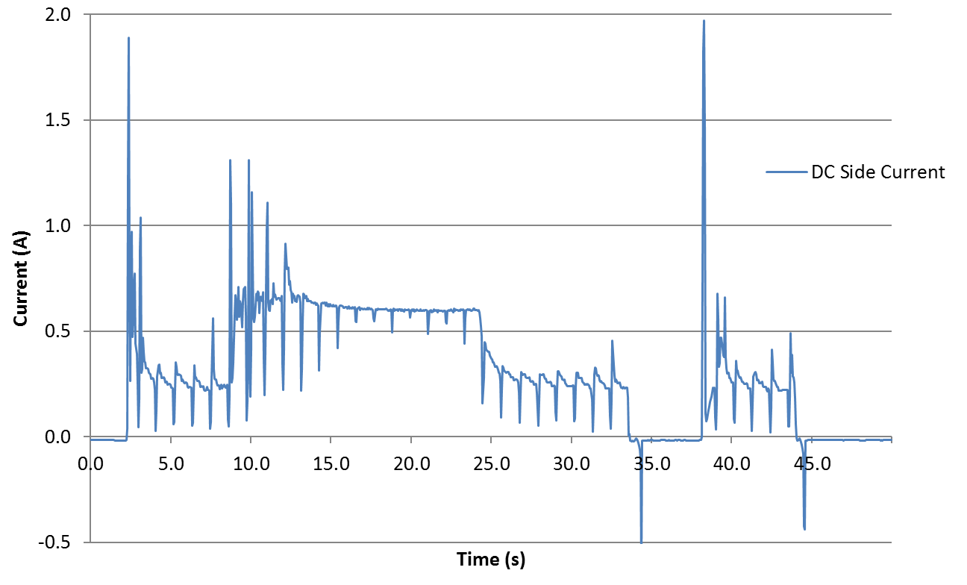
Motor Current Waveform – No Load
- Test system with current limited to 300mA normally and 600 mA in periods of ‘over current’ for 15 seconds.

Slide 12
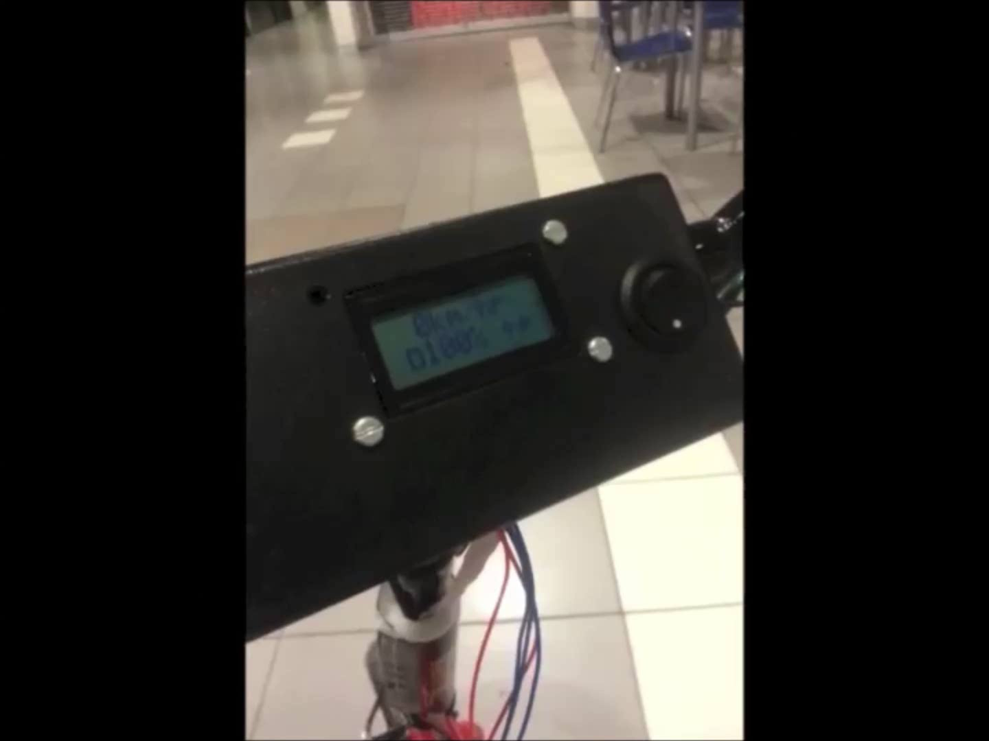
Operation

Slide 13

Performance
- Top speed of around 15 $km$/$hr$.
- Expected Range of 20km based on an average speed of 10km/hr at 150W.
Future Work
Insulation and Protection.
Regenerative Breaking Full Current Testing.
Increased Acceleration (Struggles with inclines).
Acknowledgements:
Dave Healy (Mechanical Fabrication).
Ken Smart (Workshop Assistance / Mechanical Load).

Slide 14
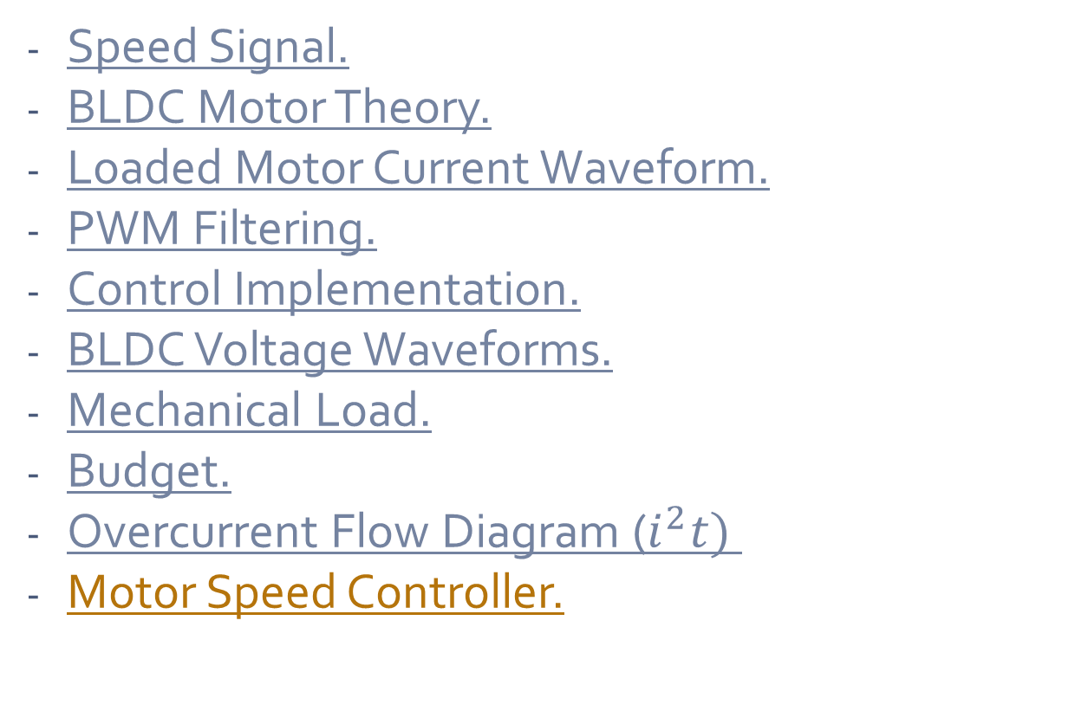
Appendices
Speed Signal.
BLDC Motor Theory.
Loaded Motor Current Waveform.
PWM Filtering.
Control Implementation.
BLDC Voltage Waveforms.
Mechanical Load.
Budget.
Overcurrent Flow Diagram ($i^{2}t)$
Motor Speed Controller.

Slide 15
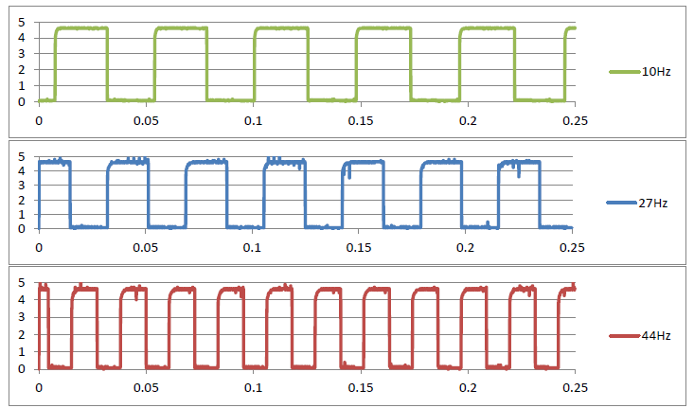





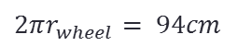

Speed Waveform
$$V_{scooter}= \frac{C_{\left(ms^{−1} → kmhr^{−1}\right)}×2πr_{wheel}×f_{signal}}{N_{Hall Effect Sensors }}$$
$$4 km hr^{−1}$$
$$C_{\left(ms^{−1} → kmhr^{−1}\right)}×=3.6$$
$2πr_{wheel}$ $= 94cm$
$$11 km hr^{−1}$$
$N_{Hall Effect Sensors }$ $= 8$
$$18 km hr^{−1}$$
$$Return$$

Slide 16
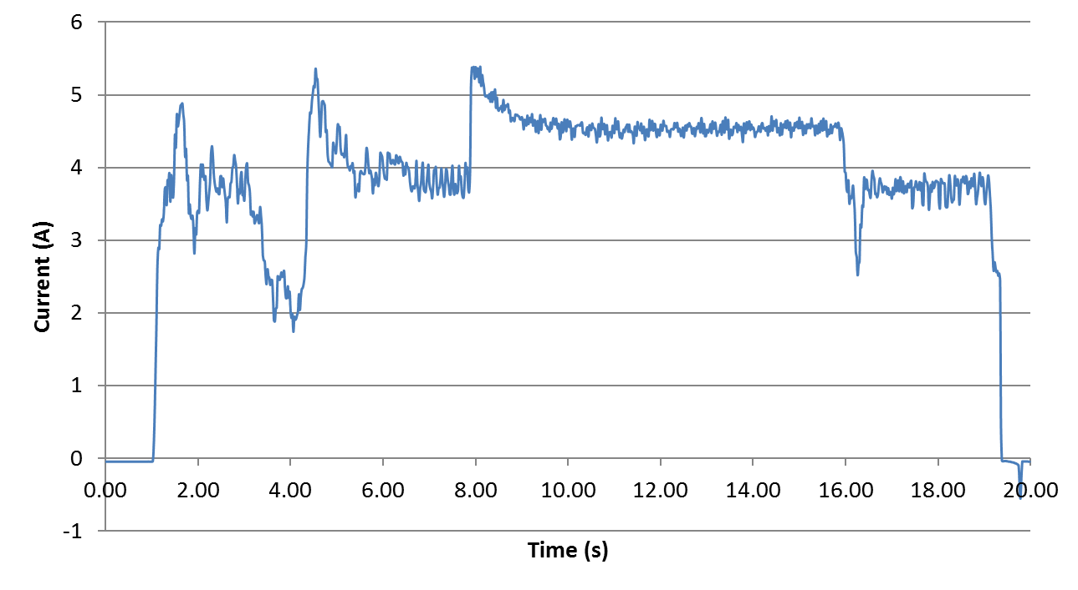

Motor Current Waveform (Loaded)
Current Control Parameters:
- $I_{rated}=3.5A$
- $I_{over−current}=7A$
$$Return$$

Slide 17
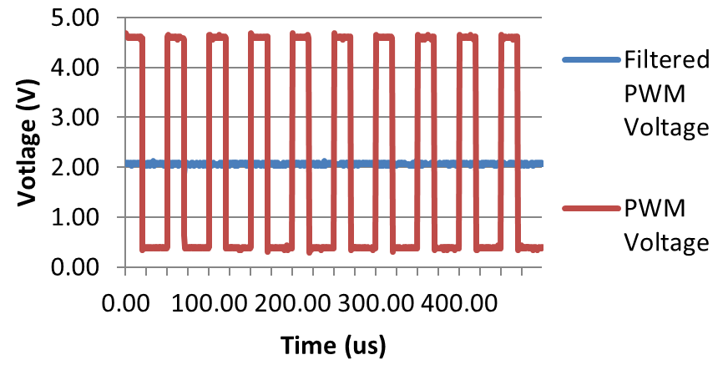
PWM Filtering
$$Return$$

Slide 18
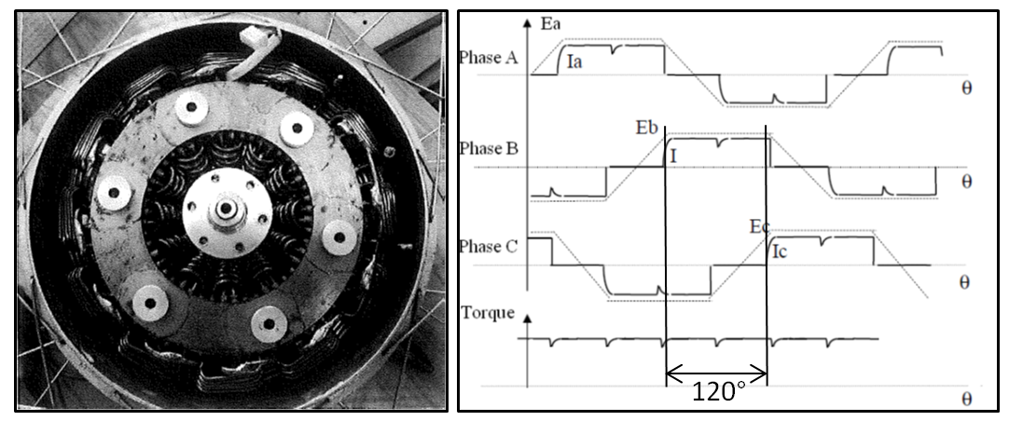
Theoretical BLDC Waveforms
$$Return$$

Slide 19
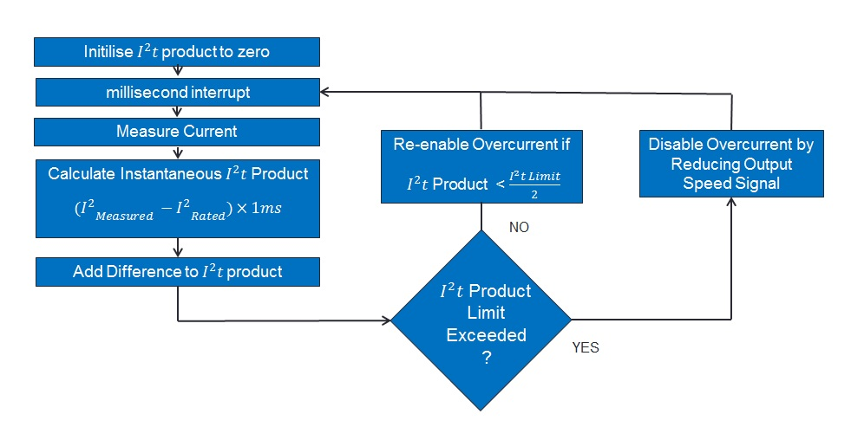
Overcurrent Flow Diagram
$$Return$$

Slide 20
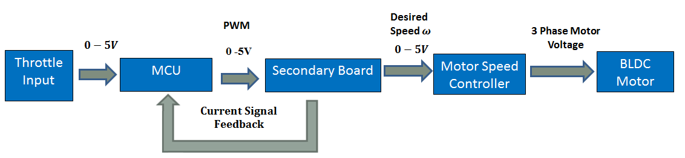

Control Implementation
- Uses PI control to limit current.
- Uses $i^{2}t$ to determine which current to limit to.
$$Return$$

Slide 21
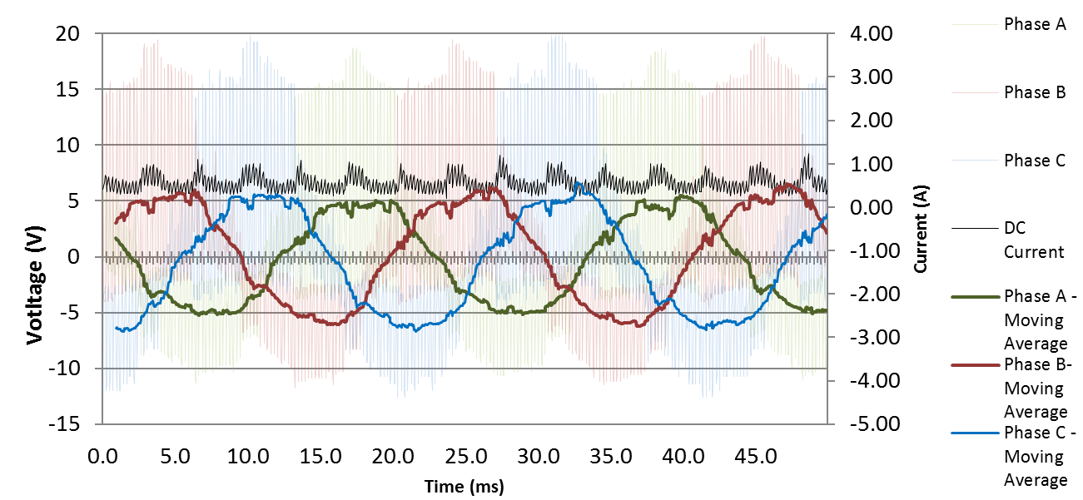
BLDC Voltage Waveforms
$$Return$$

Slide 22
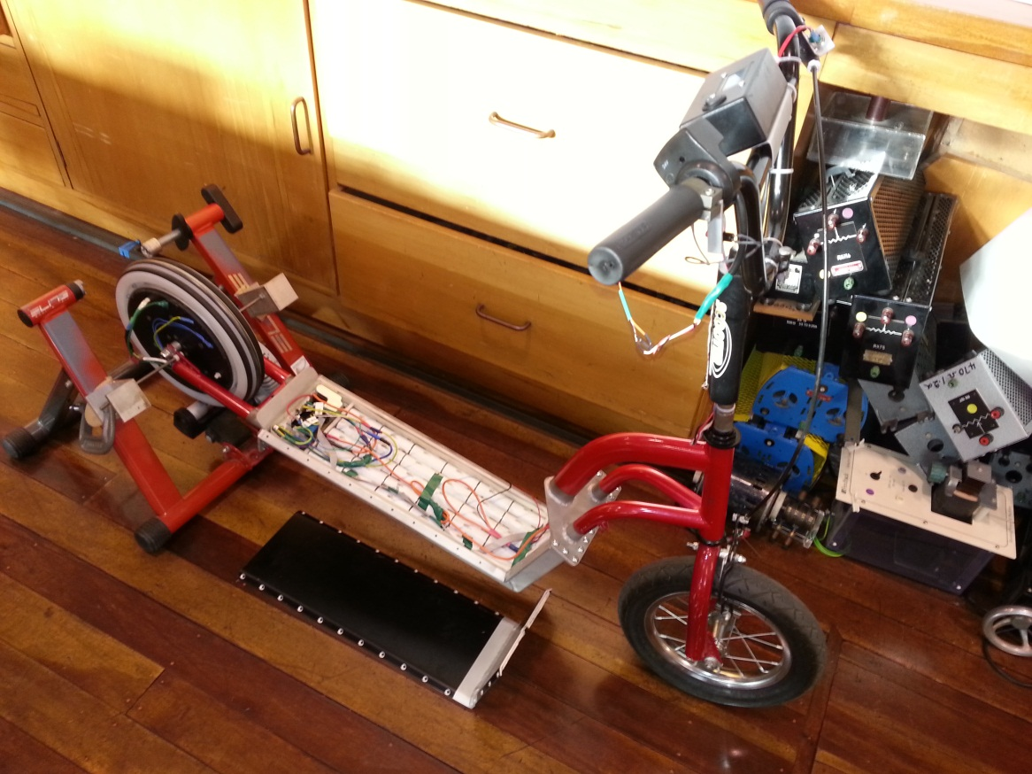
Mechanical Load
$$Return$$

Slide 23
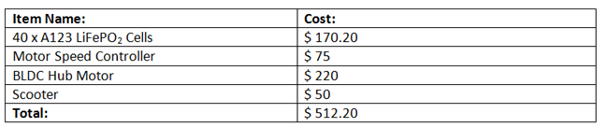
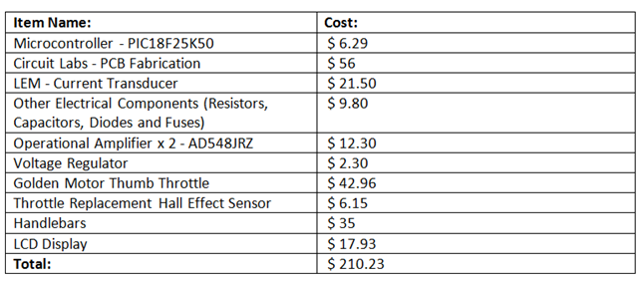
Budget
Purchases Already Made Prior To Project.
Purchased Made For Direct Drive Electric Scooter Project.
$$Return$$

Slide 24
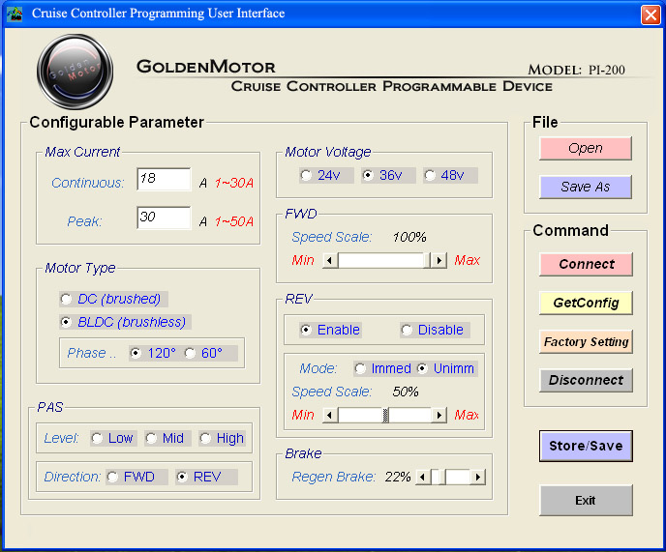
Motor Speed Controller
$$Return$$

